Slide 1
Campus Requirement System
Submitted by,

Slide 2
Abstract
Online Placement Portal is used to automate and simplify the process of registration
Company view, details of applied students and check the eligible criteria of student for the placement of particular company and also view the list of selected student details.
The placement officer easily sends mail of selected student names to their respective department.
The student can view the alumni placement details.
This portal is efficient one to use and security based also.
Our portal allows the authentic person to access data

Slide 3
MODULES
Login module
Student details module
Student document upload module
Company module
Placement details module
Report module

Slide 4
Hardware requirement
System : Intel core / i3 / i5
Bus speed : 3 GHz
Ram : 8 GB
Hard Disk Capacity : 1 TB

Slide 5
Software Requirement
Operating system : Windows 10/11
Front – End : HTML, CSS
Server- side script : PHP
Back - End : My SQL

Slide 6
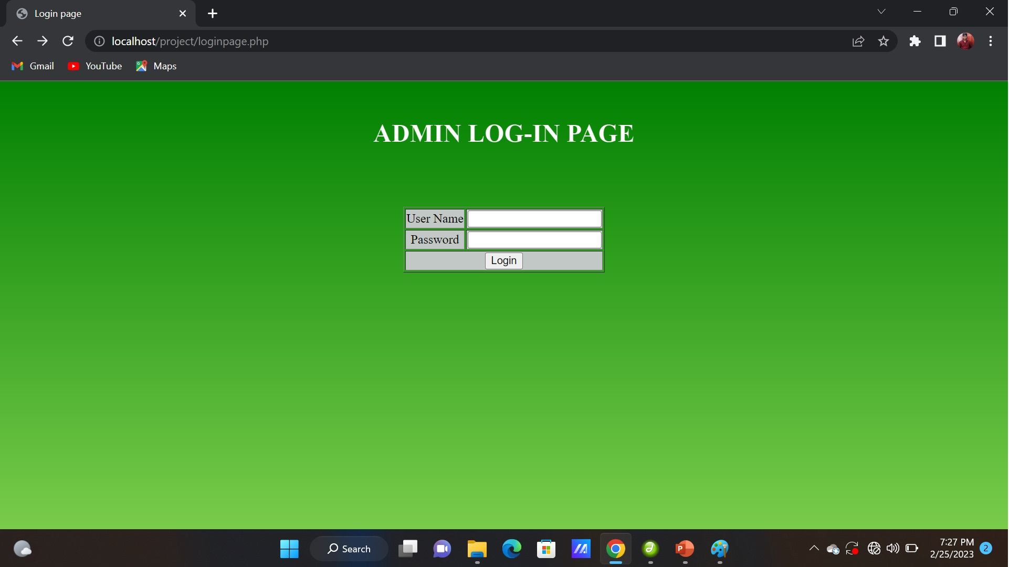
Admin log-in page

Slide 7
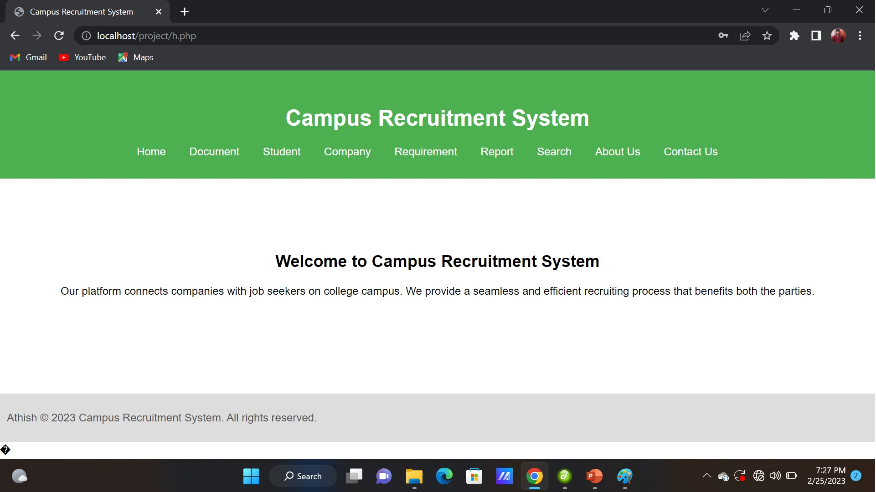
Home page

Slide 8
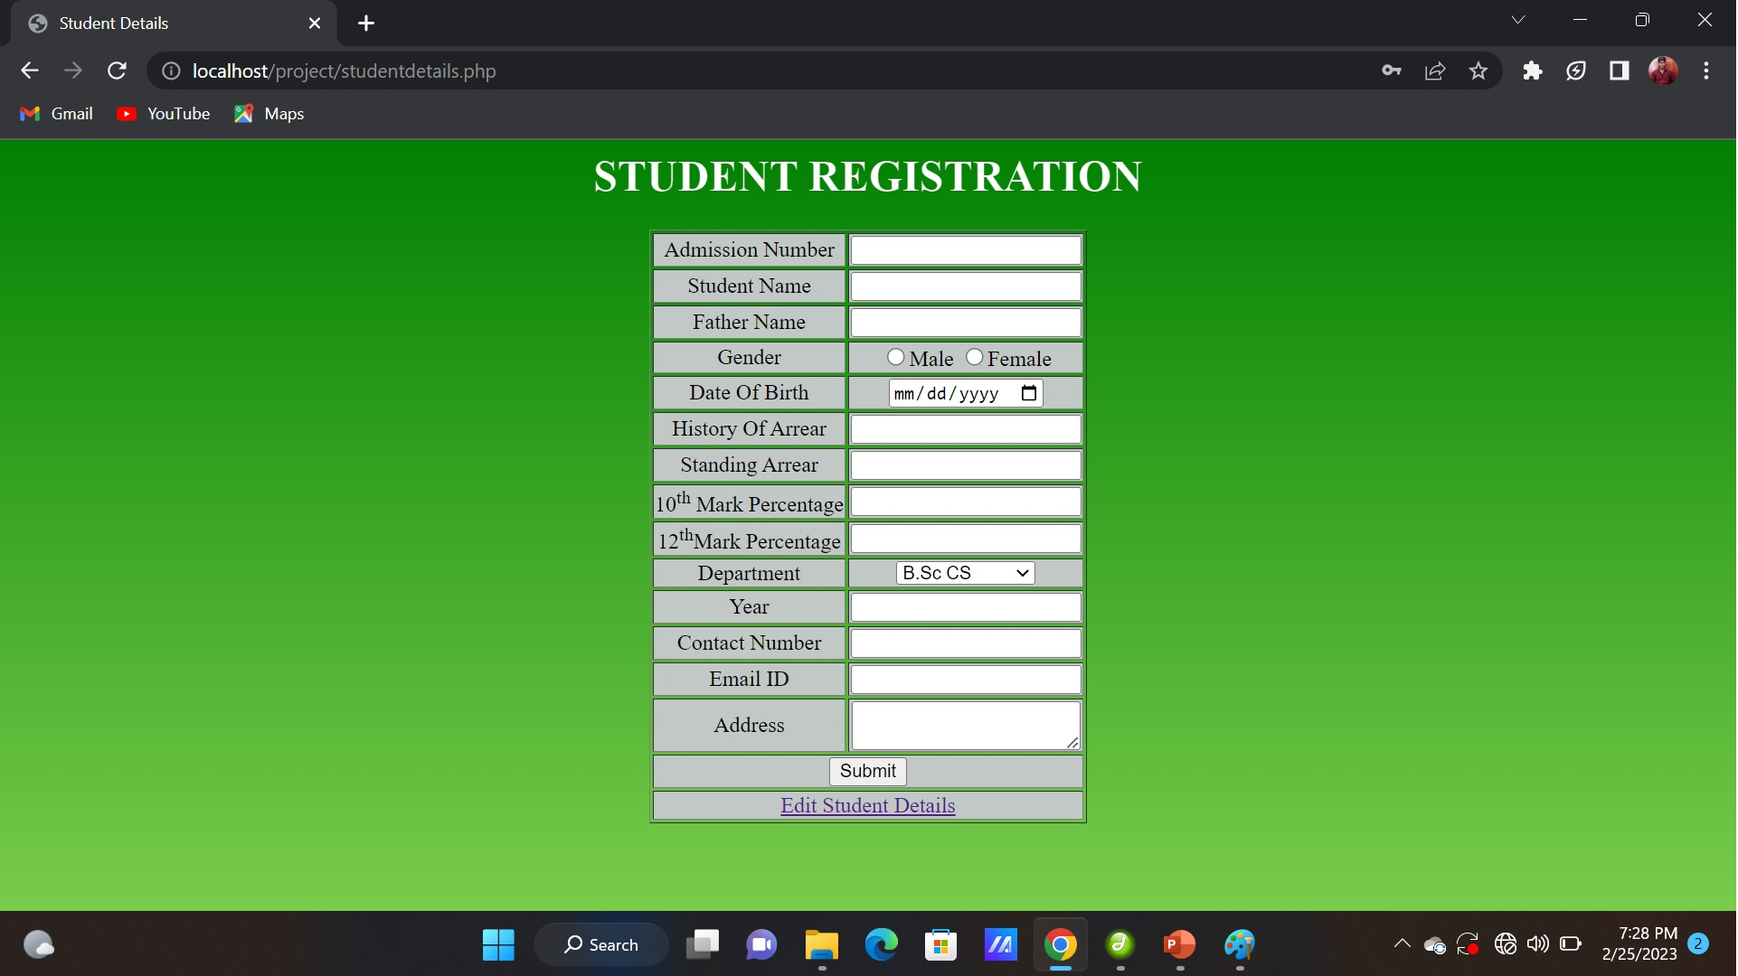
Student details registration from

Slide 9
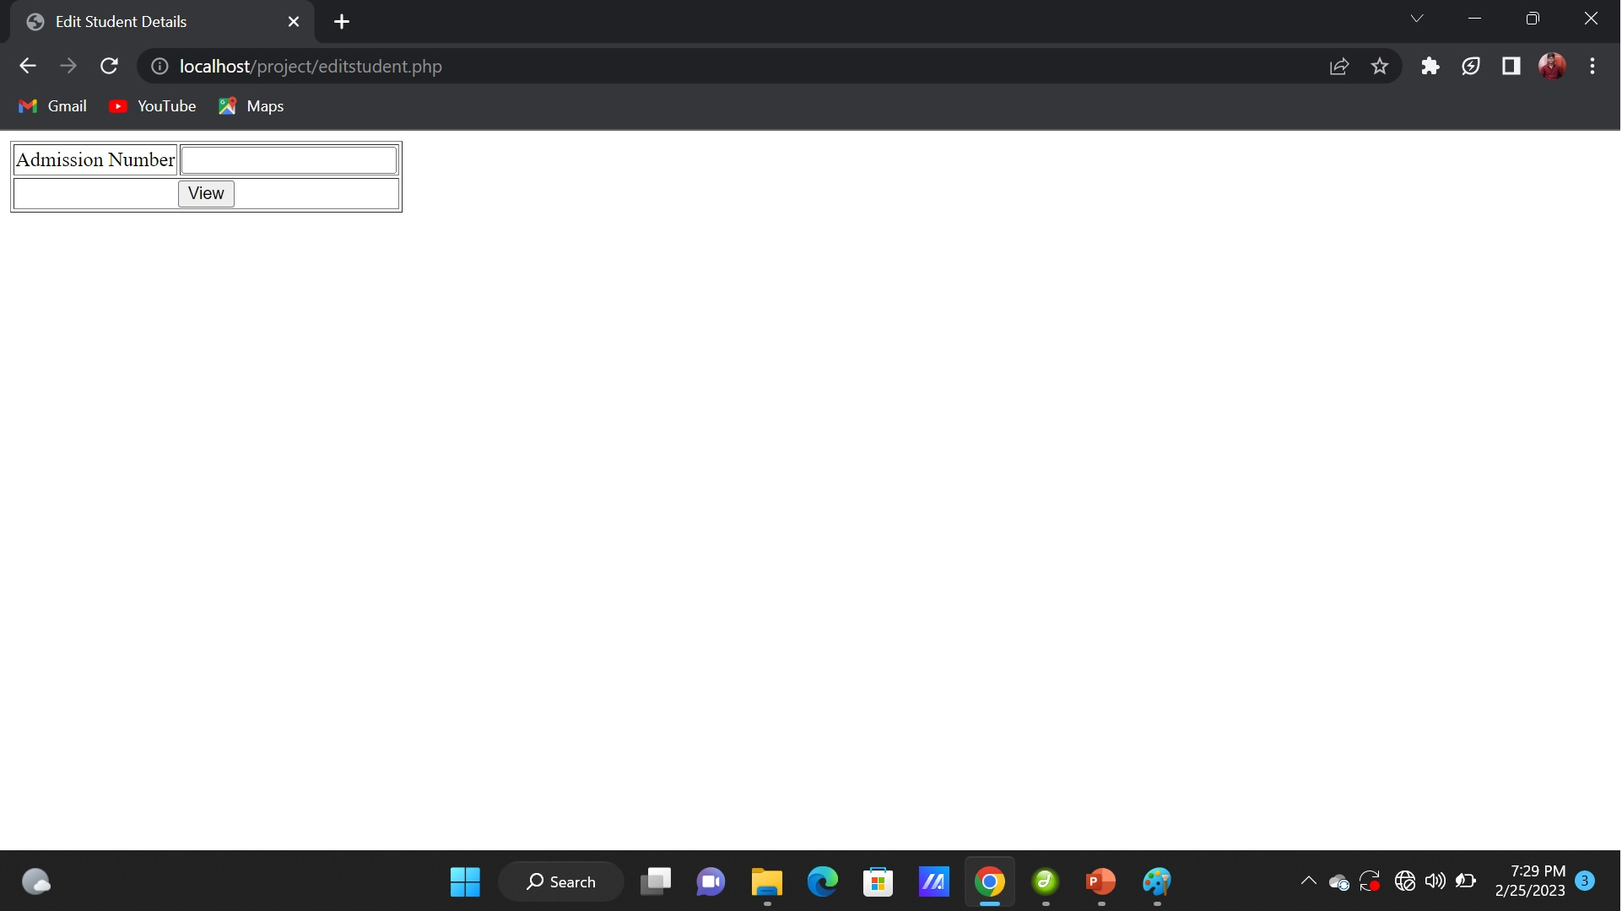
Edit - Student details page

Slide 10
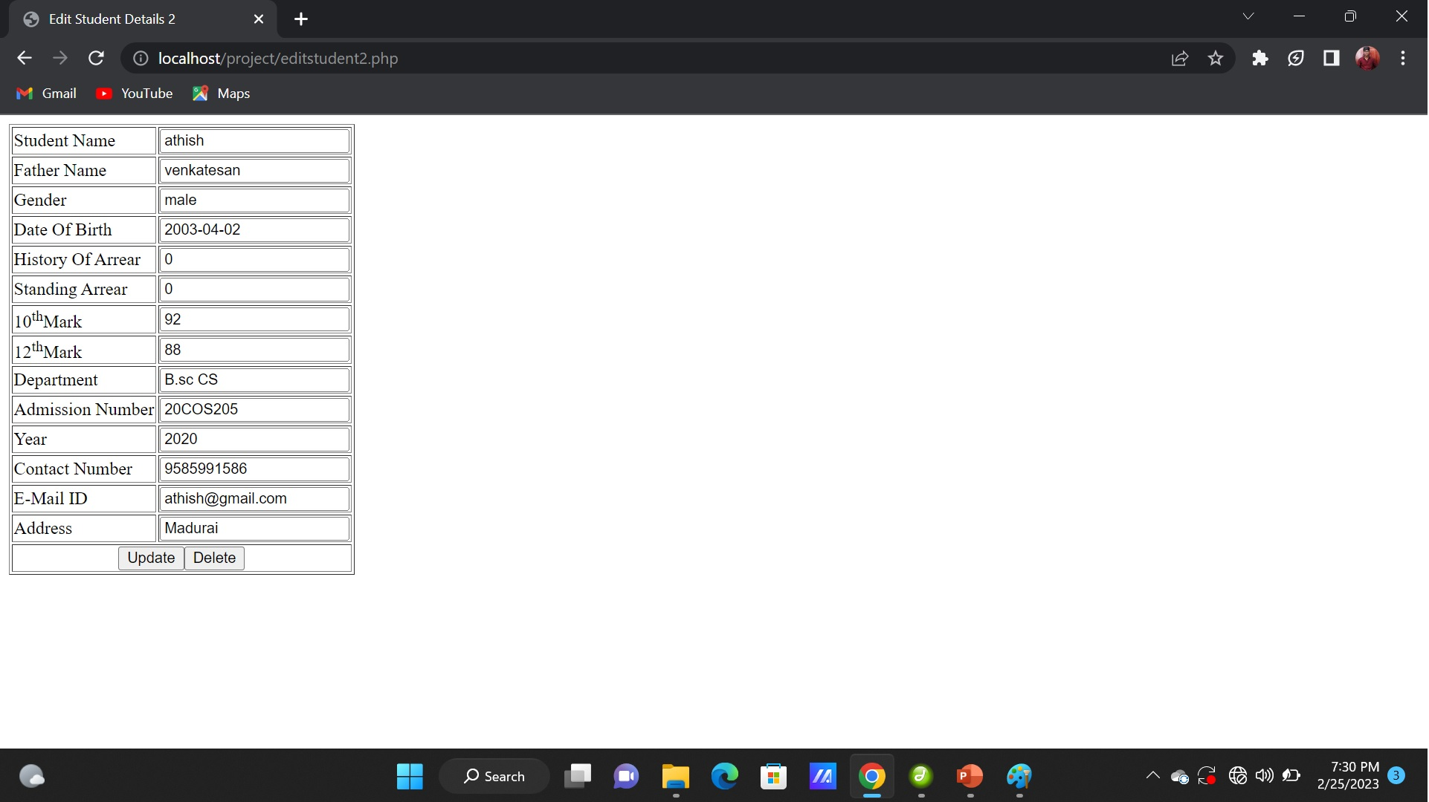
Updating student details page

Slide 11
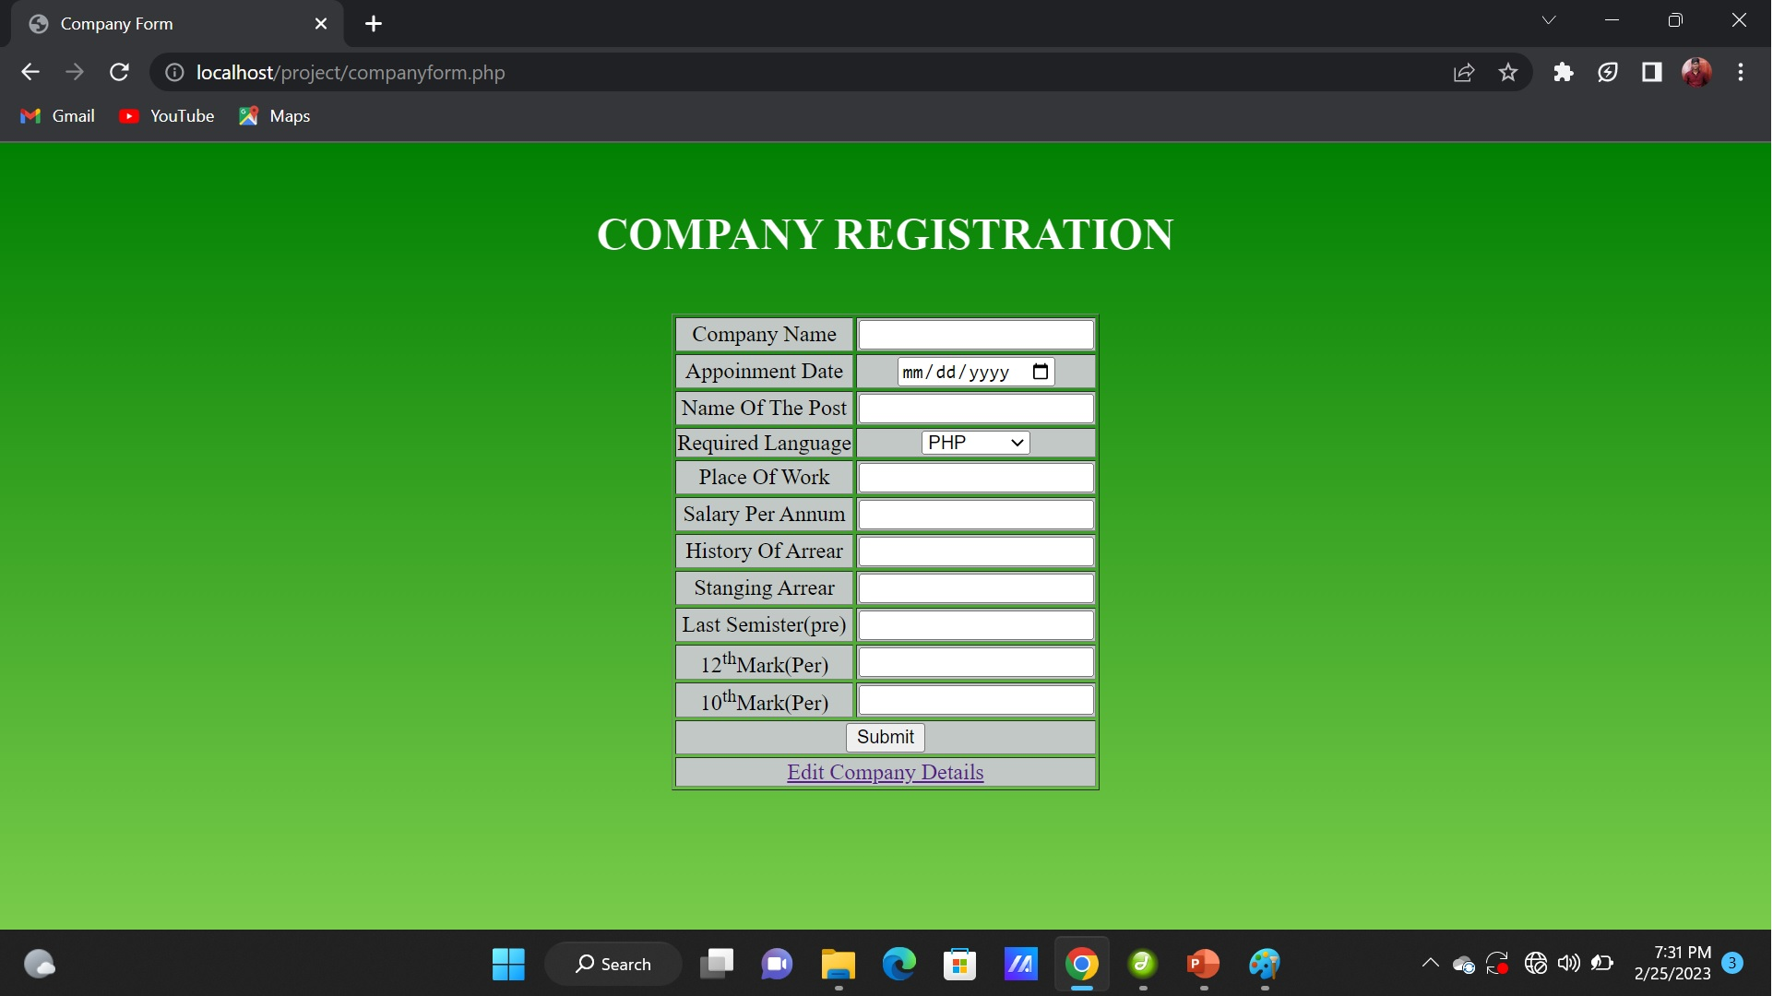
Company registration page

Slide 12

Edit – company details page

Slide 13
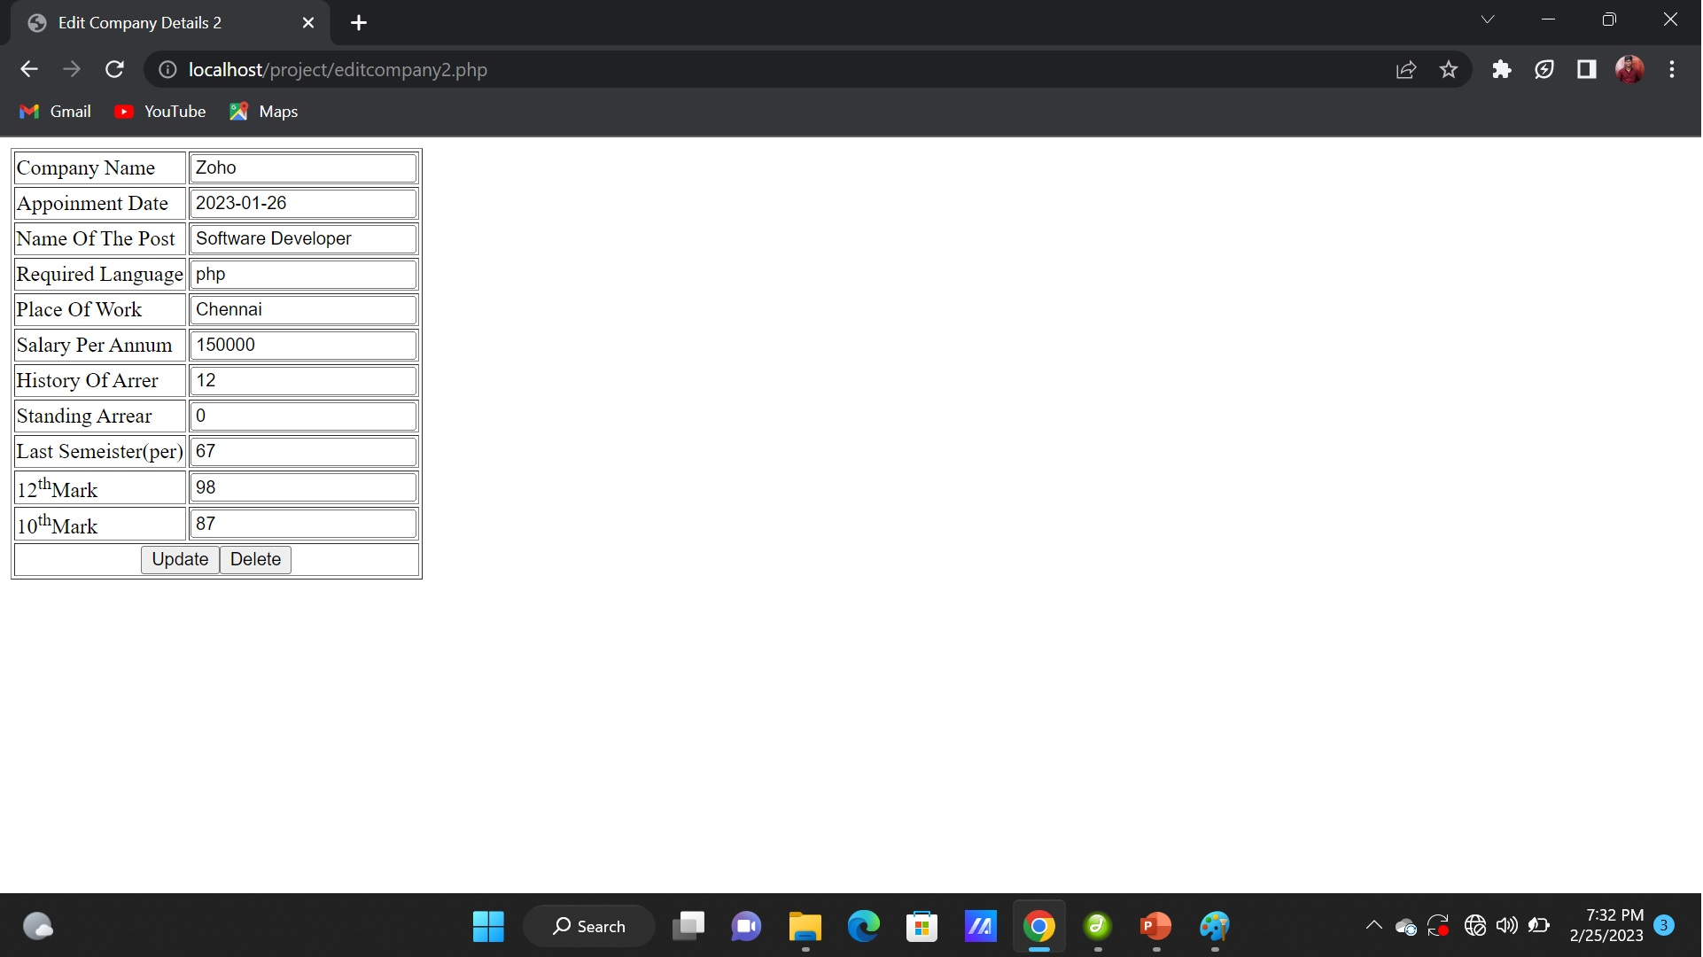
Updating company page

Slide 14
Thank you

